Slide 1
Riverhawk
World Class Solutions for Global Applications
Supplier Communication
Doing Business with Riverhawk Company

Slide 2
Riverhawk Company
Doing Business with Us
We have developed this training document in order to better communicate with our suppliers and to avoid problems as we strive for continuous improvement. It is intended to explain our basic systems and expectations.
This document is for reference only and does not supersede official Riverhawk Company communication

Slide 3
Riverhawk Company
About Riverhawk
Established in 1993
Located in New Hartford, NY
Riverhawk is a custom engineering design company.
We achieve this in one of two ways:
We can customize existing base products to specific customer applications.
We can create a new product solution for a specific customer need.
We have the ability to build most of what we design, but the designs that we cannot build ourselves can be readily built through our supply chain.

Slide 4
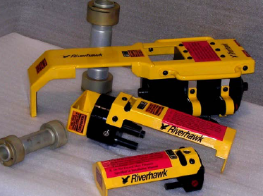
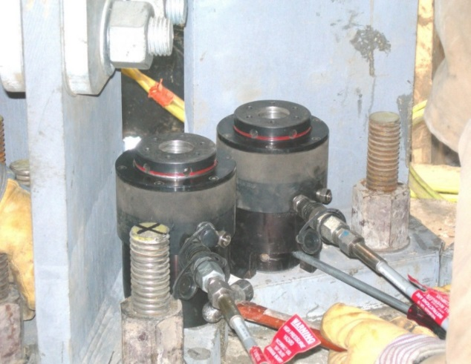
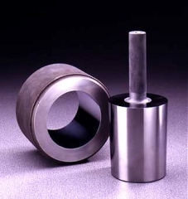
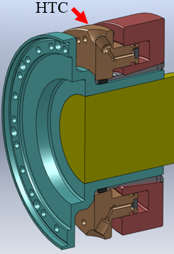
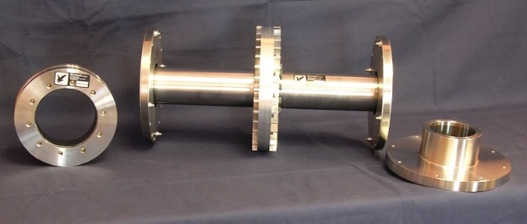
Riverhawk Company
Bolt Tensioning Systems
Numerous Engineered Solutions
Engineered Studs and Nuts
Shaft End Technology

Slide 5
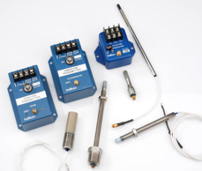
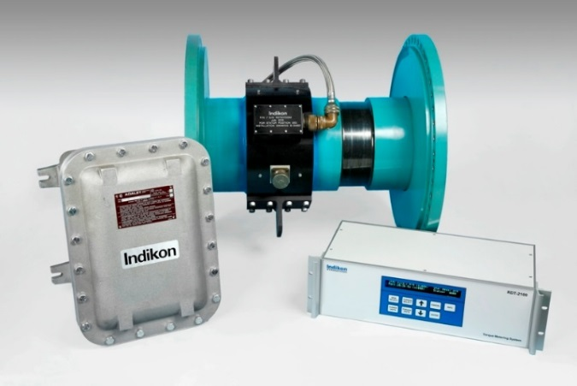
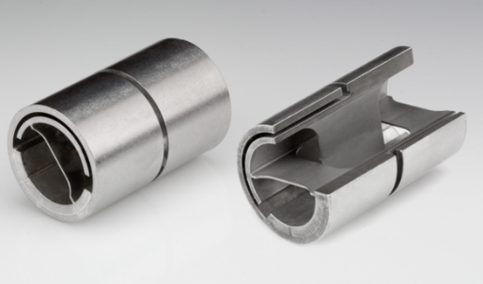
Riverhawk Company
Instrumentation
Flex Pivots

Slide 6
Riverhawk Company
Company Contacts:
Whenever possible all contact should go through your Riverhawk Buyer: 315-768-4855
Theron Colucci – Purchasing Mgr – Ext. 131
Tom Moore – Senior Buyer/Planner – Ext. 114
Pat Potaczala – Buyer/Planner – Ext. 107
Patti Calabrese – Buyer/Planner – Ext. 116
Your Riverhawk Buyer must be copied on all communications

Slide 7
Riverhawk Company
Company Contacts:
Quality questions can be directed to the following when your Buyer is not readily available:
Jeff Rhymestine –Quality Manager – Ext. 150
Please advise us of personnel changes in Quality management and Sales Contacts so we can update our records

Slide 8
Riverhawk Company
Website – www.riverhawk.com
Documents are accessible on the Supplier Portal:
QP19.0 – Supplier Quality Assurance Requirements
as referenced on your Purchase Order
Riv-150 Supplier Request for MRB Action
Riv-345 – Supplier Questionnaire (Distributors)
Riv-513 – Supplier Questionnaire
Riv-536 – Conflict Minerals Policy
Riv-544 - Terms and Conditions
PowerPoint - Supplier Corrective Action

Slide 9
Riverhawk Company
Expectations:
It is generally expected that all terms and conditions of your Purchase Order be met. We do understand that occasionally issues can arise with both Quality and Delivery of products or services and proper procedures must be followed when they do:
All Quality issues must be resolved prior to shipment of product to Riverhawk. Ref: Riv-150
Delivery Issues are to be communicated to your Buyer prior to the missed delivery promise.

Slide 10
Riverhawk Company
Expectations:
Minimum Quality System Requirements:
1) Must develop router/process plan with inspection points
documented and inspection equipment used.
2) Must maintain traceability on material used – reference on
router. Also reference Riverhawk PO on router.
3) Must inspect product with calibrated instruments.

Slide 11
Riverhawk Company
Expectations:
When products are rejected at Riverhawk, an MRR will be written and appropriate disposition and cause & corrective actions are required with specific requested completion dates.
Ref: PowerPoints - Determining Root Cause & Supplier Corrective Action
A key measurement at Riverhawk is our responsiveness to our customers as well as our suppliers. As one of our key measurements it is important for our supplier to share this value and always strive to meet request dates. If more time is need then contact your Riverhawk Buyer for an extension.

Slide 12
Riverhawk Company
Questions:
We encourage you to contact your Riverhawk Buyer with questions as soon as they arise. This communication will help us both ensure a high level of quality as well as on-time delivery of product.

Slide 13
Riverhawk Company
Supplier Training:
We hope that this training document has been helpful with your basic understanding of Riverhawk systems and expectations as we strive for continued success for ourselves as well as our suppliers.
Thank you for being one of our valued suppliers

